Slide 1
Data 3960 Final Presentation
By: Austin Perea & John Quijano

Slide 2
Table of contents
01
03
Introduction
Research Questions
02
Project Overview
04
Project background and problem statement
Research questions
Preliminary Data Analysis
Data set, benefits and limitations, risk assessment
Data, Visualizations, Models

Slide 3
01
Introduction

Slide 4
Introduction
The objective of this data analytics project is to explore the factors that affect the performance of the Canadian airlines.
Improve customer experience
Increase operational efficiency.
Notes:
Introduction
The Canadian airline industry faces challenges like rising fuel costs, increased competition, and changing consumer behavior.so In order to understand the factors affecting the performance of Canadian airlines, this data analytics project is proposed. The insights from this project can help airlines make informed decisions and compete effectively in a challenging market.

Slide 5

Project Background
The airline industry is a vital part of the Canadian economy, contributing to the growth of several sectors such as tourism, trade, and commerce.
Industry has :
Been steadily growing
Increased competition
Technological advances
Notes:
Project Background
The Canadian airline industry is a vital component of the country's transportation system and plays a critical role in connecting Canadians to each other and the world.
The airline industry in Canada has been growing gradually over the years, with increasing competition and technological advancements driving innovation and change.
However, despite the growth, the industry faces several challenges, such as rising fuel costs, fluctuating demand, and increasing competition, among others.

Slide 6
Project Background
Operating Expenses
Salaries, wages, and benefits
Finance
Technical
CAD 28.5 billion 4.3% increase from the previous year
aircraft fuel (16.9%), aircraft maintenance and repairs (11.5%)
23.2% of total operating expenses
aircraft lease and rentals (10.2%), and depreciation and amortization (9.7%).
Source: Canadian Transportation Agency in its report "Air Transportation in Canada“ 2019.
Notes:
According to the Canadian Transportation Agency in its report "Air Transportation in Canada"., the total operating expenses for Canadian airlines in 2019 were approximately CAD 28.5 billion, which was a 4.3% increase from the previous year. The largest expense category was salaries, wages, and benefits, which accounted for 23.2% of total operating expenses. Other major expense categories included aircraft fuel (16.9%), aircraft maintenance and repairs (11.5%), aircraft lease and rentals (10.2%), and depreciation and amortization (9.7%).

Slide 7
Problem Statement
The problem we intend to address in our Data Analytics project is to analyze the factors that affect airlines performance and identify patterns or trends that can help improve customer experience and increase operational efficiency.
Notes:
Problem statement
To understand the factors affecting the performance of Canadian airlines, this data analytics project is proposed. The project aims to provide recommendations for improving operational efficiency, customer satisfaction, and increase revenue by analyzing factors like route profitability, pricing strategies, customer loyalty, performance, and competitor behavior. The insights from this project can help Canadian airlines make informed decisions and compete effectively in a challenging market.

Slide 8
Benefits and limitations
Benefits
Limitations
Increase in revenue
Reduced costs
Increase in market share
Reduction in quality
Reduction in workforce
Flight satisfaction
Notes:
By finding ways to optimize operational efficiency, the airlines can benefit in various ways such as increasing revenue, reducing costs and increase market share in order to stay competitive and meet customer needs.
The limitations of doing this can cause a reduction in overall quality. Factors such as having a reduced workforce because of automated machines would decrease employee morale, flight satisfaction, aircraft quality, reduced production line, and unpredicted consequences of making changes.

Slide 9
02
Project Overview

Slide 10
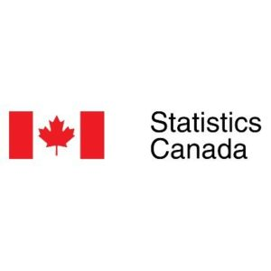
Data sets
We have a total of 6 datasets curated from StatsCanada. We are using the API to access these different datasets and pulling specific data we require for our project.

Slide 11
Project Approach
Problem
Collect Data
Clean Data
Analyze Data
Visualize
Report
Identify, goals and objectives, and scope of the project.
Gathering data from reliable sources.
Removing irrelevant data
Usable format
Descriptive
predictive, and
prescriptive analytics.
Results to stakeholders.
Data visualizations and models
Notes:
Overall, project approach follow this logical sequence of steps. This is adjusted to the business problem and data sources, and flexible enough to adapt to any changes or challenges that arise during the project.
First ,Identify the problem, outline goals and objectives, and define the scope of the project.
gathering data from sources such as databases, websites, or surveys.
Cleaning. This includes removing any irrelevant or incomplete data and ensuring that the data is in a usable format.
After the data has been cleaned, it can be analyzed. This includes using tools of descriptive analytics, predictive analytics, and prescriptive analytics to identify patterns and trends
Then Create data visualizations and models to make the data easier to understand and interpret.
Finally, present the results of the data analysis to stakeholders.

Slide 12
Risk Assesment
Data Quality
Data Integration
Data Analysis
Data Access
Accurate and complete.
Accessible and reliable.
Multiple data sources.
Insights and visualizations
Notes:
The Technical challenges that the project is facing in terms of:
Ensuring that the data is accurate and complete.
Integrating multiple data sources into a single data set.
Ensuring that the data is accessible and reliable.
Extracting insights from data and creating visualizations to make data easier to understand.
How to Address the Issues:
Data Quality: Use data cleansing techniques to ensure data is accurate and complete.
Data Integration: Use data integration tools to combine multiple data sources.
Data Mining and Analysis: Use data mining and analysis tools to uncover insights from the data.

Slide 13
03
Research Questions

Slide 14
Research Questions
What is the total number of passengers flown in Canada, and how has it changed over time?
How many hours have been flown in Canada overall, and how has that number varied over time?
How many hours did Canadian airlines fly?
Why the airlines should improve the overall customer experience.
Why the airlines should increase operational efficiency.
What are the total operating expenses for the Canadian airlines?
How much fuel and oil did the airlines consume, and how much did they spend on it?
What is the average number of employees in different departments of the Canadian airlines, and how much do they earn in wages and salaries?
What is the total operating revenue per employee?
What is the tonne-kilometres flown per employee, and how does it vary across different airlines?
How much revenue did the airlines generate from scheduled services, charter services, and other flight-related revenue?
How many carriers are there in the dataset?

Slide 15
04
Preliminary Data Analysis

Slide 16
Findings
The number of maintenance personnel employees and the Tonne-Kilometers flown by each employee are highly correlated.
Airlines with higher Total operating revenue per employee will have higher profits.
As airplanes get more fuel efficient, the percentage of all fuel and oil consumption costs to total operating revenue from scheduled and charter services will gradually declined.
The Total operating expenses of airlines with a higher number of carriers will be lower due to economies of scale.
The average number of employees in Canada will have a positive effect on the Total operating revenue, scheduled and charter services.
Scheduled and charter services provided by airlines that have a greater percentage of All Other Flight-Related Revenue to Total Operating Revenue will be more profitable.

Slide 17
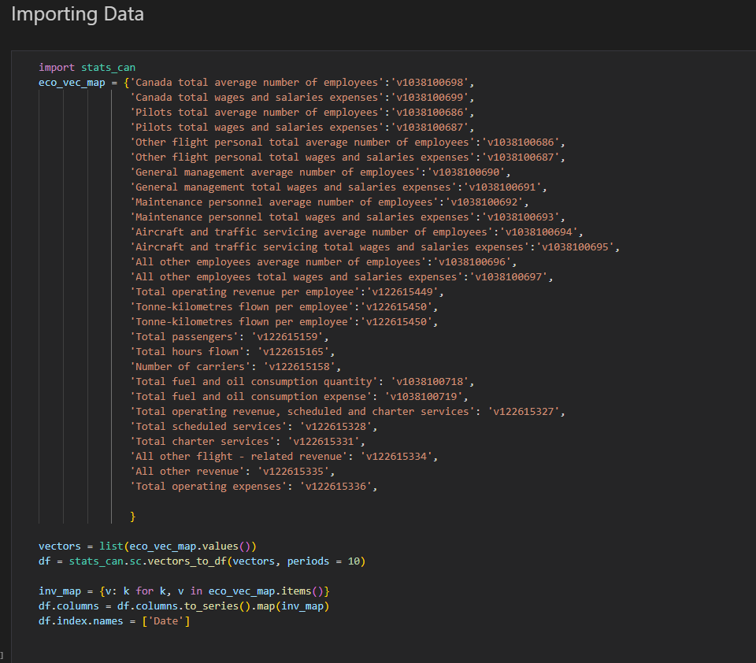
Stats Canada API

Slide 18
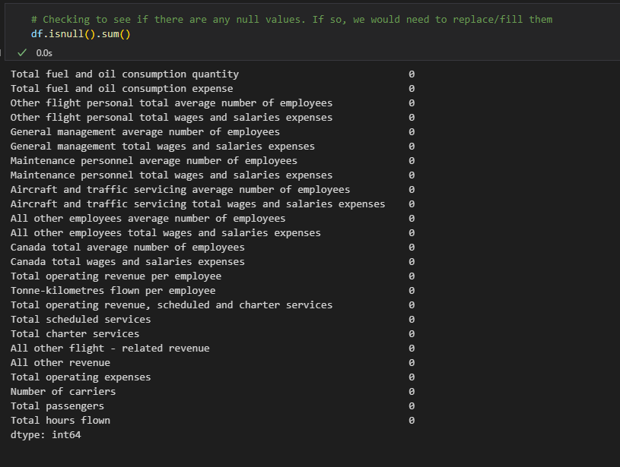

Slide 19
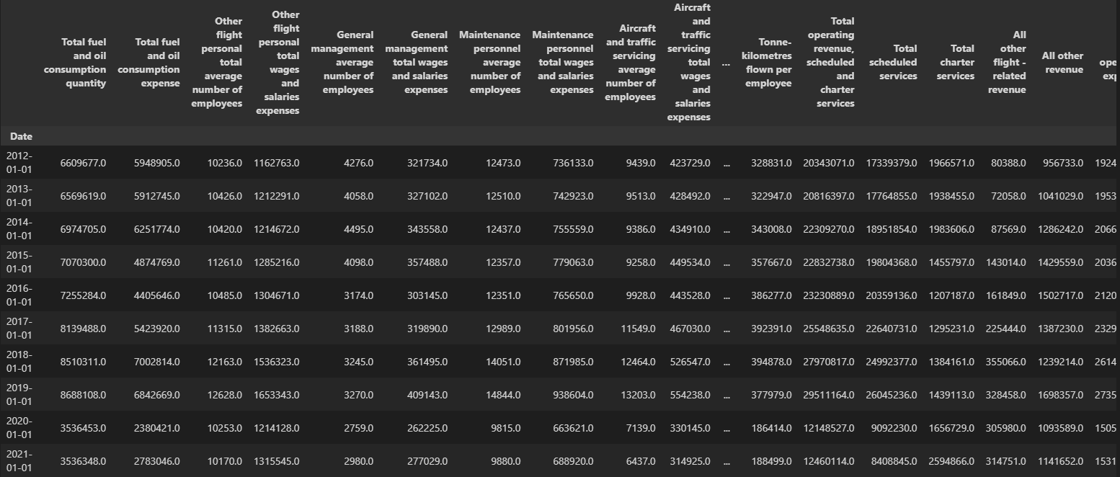

Slide 20
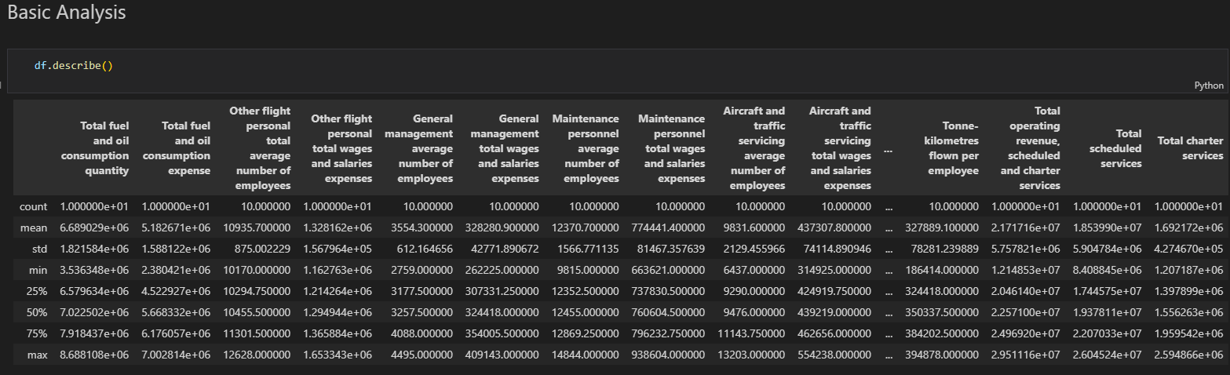

Slide 21
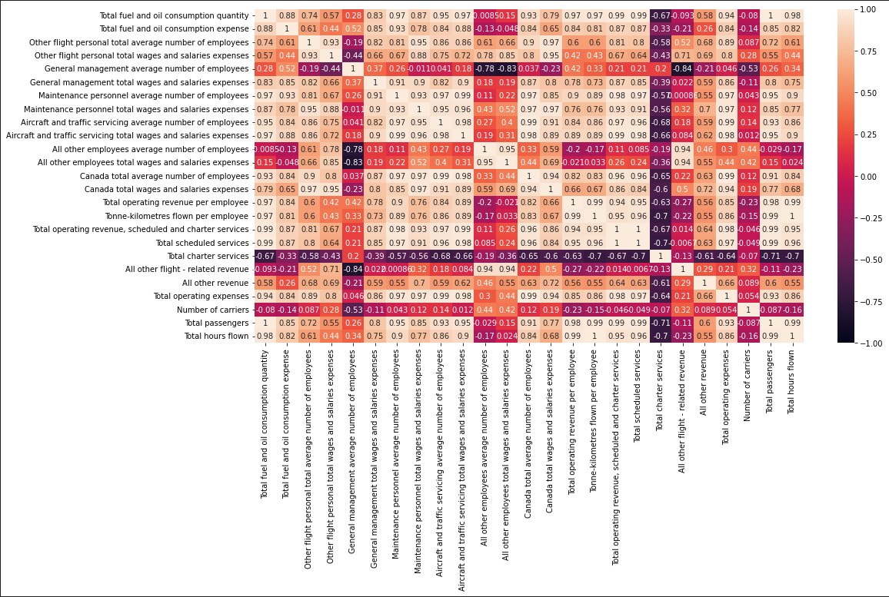
Notes:
Here we have a heatmap that displays the matrix of data, where we see the relationships between attributes: the heatmap represents data from multiple variables, and we use it to look for relationships between the variables for our analysis

Slide 22
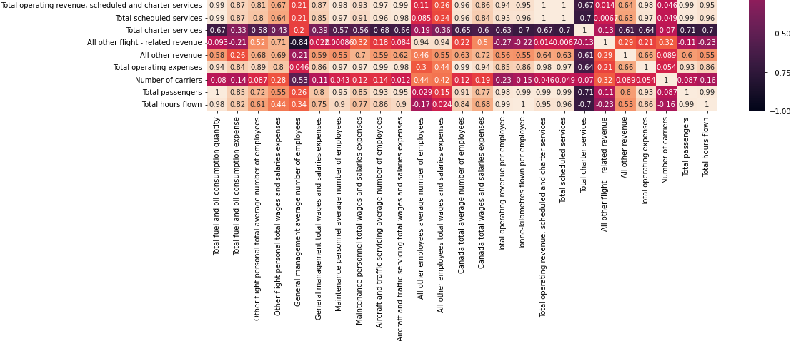
Notes:
We can interpret that:
<p>There is a high correlation for operating revenue with:
<ul>
<li>Maintenance personal average number of employees (0.98) </li>
<li>Aircraft and traffic servicing number of employees (0.97) </li>
<li>Aircraft and traffic total wages and salaries expenses (0.99) </li>
<li>Total fuel and oil consumption quantity (0.99) </li>
<li>Total fuel and oil consumption expense (0.87)</li>
<li>Canada total average number of employees (0.96)</li>
<li>Total scheduled services (1)</li>
<li>Total operating expense (0.98)</li>
<li>Total passengers (0.99)</li>
<li>Total hours flown (0.95)</li>
</ul>

Slide 23
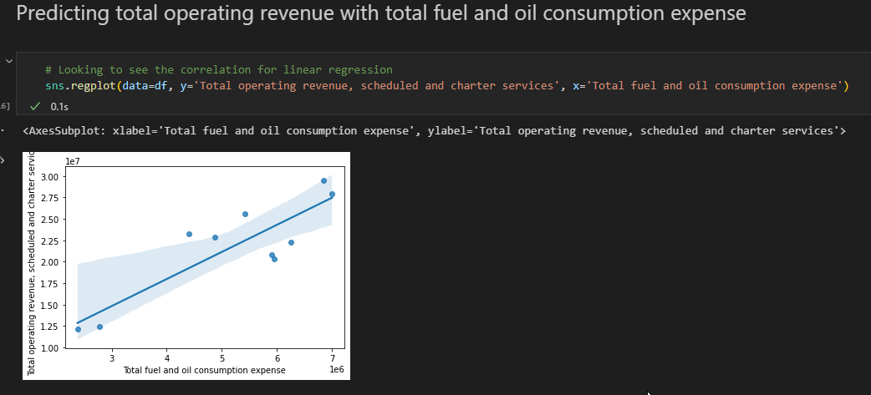
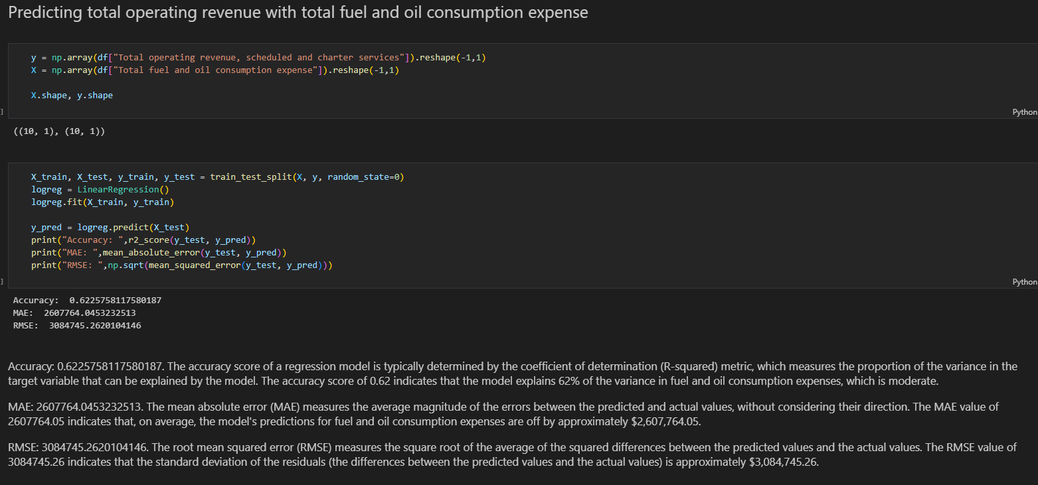
Notes:
Here we tried DecisionTreeRegressor model
The accuracy score of 0.95 indicates that the model explains 95% of the variance in fuel and oil consumption expenses, which is high.

Slide 24
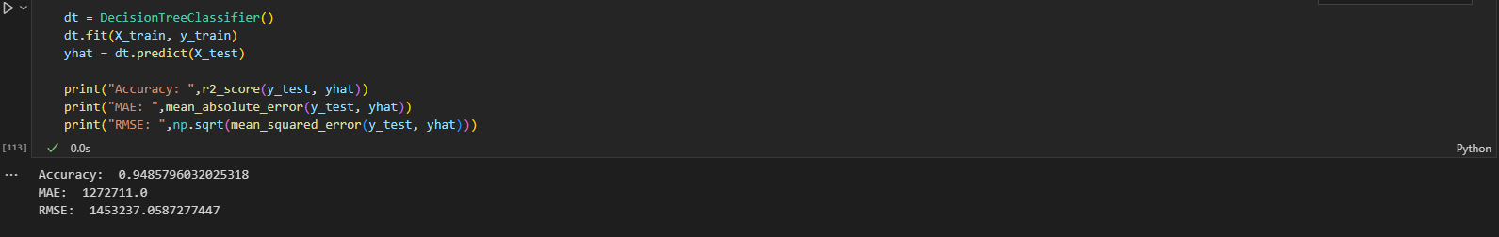
Notes:
These metrics suggest that the model's predictions have a relatively low level of error, with a smaller difference between the predicted and actual values compared to the LinearRegression model. Therefore, the DecisionTreeRegressor model is likely to be a better choice for predicting fuel and oil consumption expenses based on total operating revenue.
Our next goal is to predict the other high correlation columns and make a pipeline where we can more features/parameters to improve our model.

Slide 25
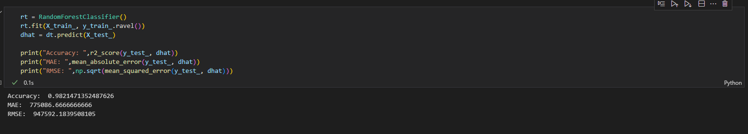

Slide 26
Thanks!
Do you have any questions?

